Slide 1
Machine Learning
Tree-Based Models in R
June 2019

Slide 2
Content
Classification Trees
Welcome to the course!
Build a classification tree
Introduction to classification trees
Advantages of tree-based methods
Prediction with a classification tree
Overview of the modeling process
Train / test split
Train a classification tree model
Evaluating classification model performance
Compute confusion matrix
Splitting criterion in trees
Compare models with a different splitting criterion
Regression Trees
Introduction to regression trees
Classification versus regression
Split the data
Train a regression tree model
Performance metrics for regression
Evaluate a regression tree model
What are the hyperparameters for a decision tree?
Tuning the model
Grid search for model selection
Generate a grid of hyperparameter values
Generate a grid of models
Evaluate the grid
Bagged Trees
Introduction to bagged trees
Advantages of bagged trees
Train a bagged tree model
Evaluating the bagged tree performance
Prediction and confusion matrix
Predict on a test set and compute AUC
Using caret for cross-validating models
Cross-validate a bagged tree model in caret
Generate predictions from the caret model
Compare test set performance to CV performance
Random Forests
Introduction to random forest
Bagged trees versus random forest
Train a random forest model
Understanding random forest model output
Evaluate out-of-bag error
Evaluate model performance on a test set
OOB error versus test set error
Advantage of OOB error
Evaluate test set AUC
Tuning a random forest model
Tuning a random forest via mtry
Tuning a random forest via tree depth

Slide 3
Content
Boosted Trees
Introduction to boosting
Bagged trees versus boosted trees
Train a GBM model
Understanding GBM model output
Prediction using a GBM model
Evaluate test set AUC
GBM hyperparameters
Early stopping in GBMs
OOB versus CV-based early stopping
Model comparison via ROC curve and AUC
Compare all models based on AUC
Plot and compare ROC curves

Slide 4
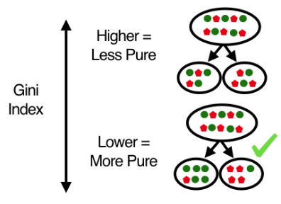
creditsub is a data frame
libraries → rpart, caret
credit_model <- rpart(formula = default ~ .,
data = creditsub,
method = “class”)
rpart.plot(x = credit_model, yesno = 2, type = 0, extra = 0)
Advantage of Decision Trees
Simple to understand, interpret, and visualize
Can handle both numerical and categorical features natively
Can handle missing data elegantly
Robust to outliers
Requires little data preparation
Can model non-linearity in the data
Can be trained quickly on large datasets
Disadvantage of Decision Trees
Large tree can be hard to interpret
Trees have high variance, whick causes model performance to be poor
Tree overfit easily
n <- nrow(creditsub)
n_train <- round(0.8 * n)
set.seed(123)
train_indices <- sample(1:n, n_train)
creditsub_train <- creditsub[train_indices, ]
creditsub_test <- creditsub[-train_indices, ]
credit_model <- rpart(formula = default ~ .,
data = creditsub_train,
method = “class”
parms = list(split = “gini”))
default_prediction <- predict(object = credit_model,
newdata = creditsub_test,
type = “class”)
confusionMatrix(data = default_prediction, reference = creditsub_test$default)
ce(actual = creditsub_test$default, predicted = default_prediction)
you can also use “information”
performance metrics
Classification Trees

Slide 5
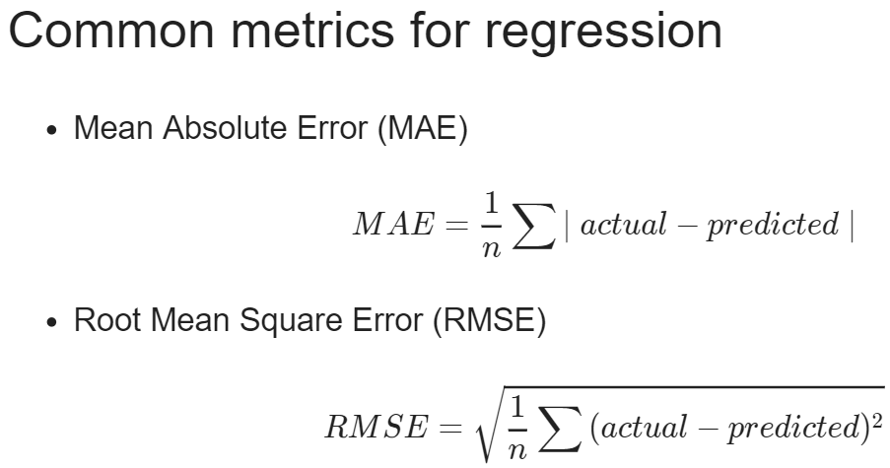
grade is a data frame
libraries → Metrics
set.seed(1)
assignment <- sample(1:3, size = nrow(grade), prob = c(0.7, 0.15, 0.15), replace = TRUE)
grade_train <- grade[assignment == 1, ]
grade_valid <- grade[assignment == 2, ]
grade_test <- grade[assignment == 3, ]
grade_model <- rpart(formula = final_grade ~ .,
data = grade_train,
method = “anova”)
rpart.plot(x = grade_model, yesno = 2, type = 0, extra = 0)
grade_pred <- predict(object = grade_model, newdata = grade_test)
library(Metrics)
rmse(actual = grade_test$final_grade, predicted = grade_pred)
plotcp(grade_model) print(grade_model$cptable)
opt_index <- which.min(grade_model$cptable[ , “xerror”])
cp_opt <- grade_model$cptable[opt_index, “CP”]
grade_model_opt <- prune(tree = grade_model, cp = cp_opt)
rpart.plot(x = grade_model_opt, yesno = 2, type = 0, extra = 0)
you can see this model using print(grade_model)
Regression Trees

Slide 6
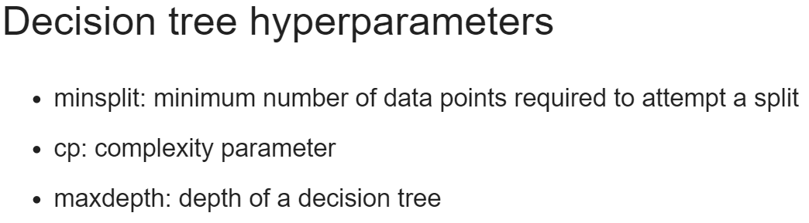
minsplit <- seq(1, 4, 1)
maxdepth <- seq(1, 6, 1)
hyper_grid <- expand.grid(minsplit = minsplit, maxdepth = maxdepth)
num_models <- nrow(hyper_grid)
grade_models <- list()
for (i in 1:num_models) {
minsplit <- hyper_grid$minsplit[i]
maxdepth <- hyper_grid$maxdepth[i]
grade_models[[i]] <- rpart(formula = final_grade ~ .,
data = grade_train,
method = “anova”,
minsplit = minsplit,
maxdepth = maxdepth)
}
num_models <- length(grade_models)
rmse_values <- c()
for (i in 1:num_models) {
model <- grade_models[[i]]
pred <- predict(object = model, newdata = grade_valid)
rmse_values[i] <- rmse(actual = grade_valid$final_grade, predicted = pred)
}
best_model <- grade_mdoels[[which.min(rmse_values)]] best_model$control
pred <- predict(object = best_model, newdata = grade_test)
rmse(actual = grade_test$final_grade, predicted = pred)
Just like a test set, a validation set is used to evaluate the performance of a model. The difference is that a validation set is specifically used to compare the performance of a group o fmodels with the goal of choosing a “best model” from the group. All models in a group are evaluated on the same validation set and the model with the best performance is considered to be the winner.
Once you have the best model, a final estimate of performance is computed on the test set.
Regression Trees

Slide 7
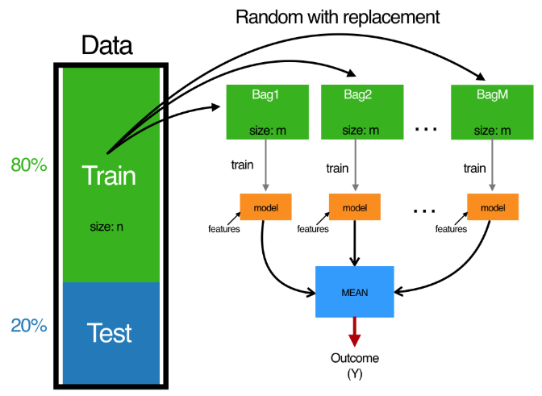
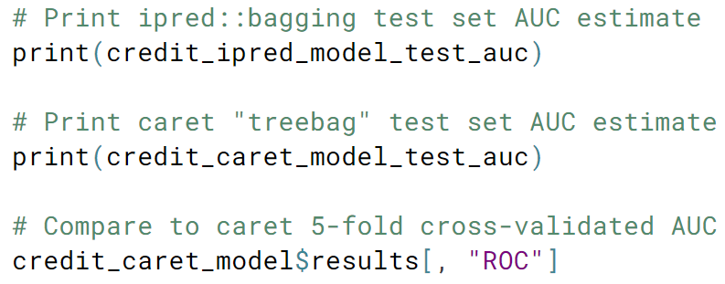
creditsub is a data frame
libraries → ipred, Metrics, caret
Bagged trees combines many trees with the goal of reducing variance.
Bagging ← Bootstrap Aggregating
model object names(credit_model)
set.seed(123)
credit_model <- bagging(formula = default ~ .,
data = credit_train, coob = TRUE)
credit_pred <- predict(object = credit_model,
newdata = credit_test, type = “class”)
auc(actual = ifelse(credit_test$default == “yes”, 1, 0),
predict = pred[ , “yes”])
ctrl <- trainControl(method = “cv”,
number = 5,
clasasProbs = TRUE,
summaryFunction = twoClassSummary)
set.seed(1)
credit_caret_model <- train(default ~ .,
data = credit_train,
method = “treebag”,
metric = “ROC”,
trControl = ctrl)
credit_caret_model$results[ , “ROC”]
credit_pred <- predict(object = credit_caret_model,
newdata = credit_test, type = “prob”)
auc(actual = ifelse(credit_test$default == “yes”, 1, 0),
predict = pred[ , “yes”])
“prob” changes this to a predicted value as opposed to a class label
In binary classification, we can predict numeric values instead of class labels. In fact, class labels are created only after you use the model to predict a raw, numeric, predicted value for a test point.
The predicted label is generated by applying a threshold to the predicted value, such that all test points with predicted value greater than the threshold get a label of “1” and points below get a label of “0”.
model object names(credit_caret_model)
Bagged Trees

Slide 8
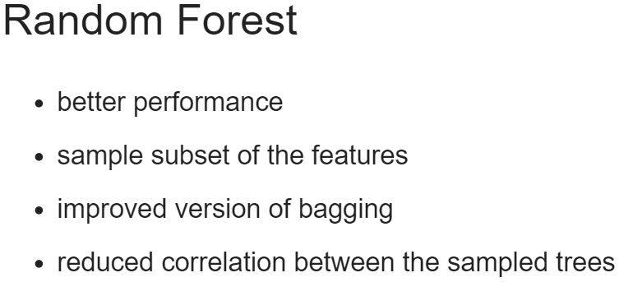
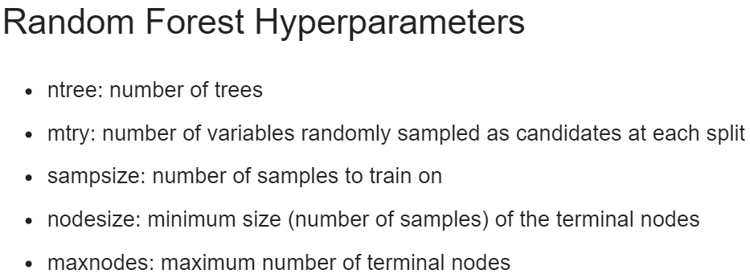
creditsub is a data frame
libraries → randomForest, caret
set.seed(1)
library(randomForest)
credit_model <- randomForest(formula = default ~ ., data = credit_train)
err <- credit_model$err.rate
oob_err <- err[500, “OOB”]
plot(credit_model)
legend(x = “right”, legend = colnames(err), fill = 1:ncol(err))
credit_pred <- predict(object = credit_model,
newdata = credit_test, type = “class”)
cm <- confusionMatrix(data = class_prediction,
reference = credit_test$default)
paste0(“Test Accuracy: ”, cm$overall[1])
paste0(“OOB Accuracy: ”, 1 – obb_err)
credit_pred <- predict(object = credit_caret_model,
newdata = credit_test, type = “prob”)
auc(actual = ifelse(credit_test$default == “yes”, 1, 0),
predict = pred[ , “yes”])
set.seed(1)
res <- tuneRF(x = subset(credit_train, select = -default),
y = credit_train$default, ntreeTry = 500)
mtry_opt <- res[ , “mtry”][which.min(res[ , “OOBError”])]
model object names(credit_model)
OOB (out-of-bag error)
mtry <- seq(4, ncol(credit_train) * 0.8, 2)
nodesize <- seq(3, 8, 2)
sampsize <- nrow(credit_train) * c(0.7, 0.8)
hp_grid <- expand.grid(mtry = mtry,
nodesize = nodesize,
sampsize = sampsize)
for (i in 1:nrow(hp_grid) {
model <- randomForest(formula = default ~.,
data = credit_train,
mtry = hp_grid$mtry[i],
nodesize = hp_grid$nodesize[i],
sampsize = hp_grid$sampsize[i])
obb_err[i] <- model$err.rate[nrow(model$err.rate), “OOB”]
}
opt_i <- which.min(obb_err)
print(hp_grid[opt_i, ])
Note: if you want to evaluate the model based on AUC instead of error (accuracy), then this is not the best way to tune a model, as the selection only considers OOB error.
Random Forests

Slide 9
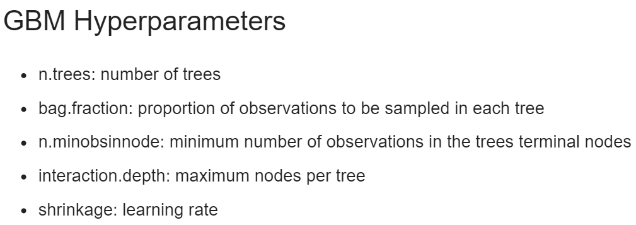
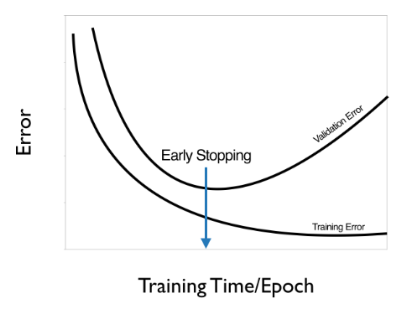
creditsub is a data frame
libraries → gbm, ROCR
credit_train$default <- ifelse(credit_train$default == “yes”, 1, 0)
set.seed(1)
library(gbm)
credit_model <- gbm(formula = default ~ .,
distribution = “Bernoulli”,
data = credit_train,
n.trees = 10000)
summary(credit_model)
credit_test$default <- ifelse(credit_test$default == “yes”, 1, 0)
credit_pred <- predict(object = credit_model,
newdata = credit_test,
n.trees = 10000)
credit_pred <- predict(object = credit_model,
newdata = credit_test,
n.trees = 10000,
type = “response”)
auc(actual = credit_test$default, predicted = credit_pred)
model object names(credit_model)
displays a variable importance table and plot
ntree_opt_oob <- gbm.perf(object = credit_model,
method = “OOB”,
oobag.curve = TRUE)
set.seed(1)
credit_model_cv <- gbm(formula = default ~ .,
distribution = “Bernoulli”,
data = credit_train,
n.trees = 10000,
cv.folds = 2)
ntree_opt_cv <- gbm.perf(object = credit_model,
method = “cv”)
pr1 <- predict(object = credit_model,
newdata = credit_test,
n.trees = ntree_opt_oob)
pr2 <- predict(object = credit_model,
newdata = credit_test,
n.trees = ntree_opt_cv)
auc1 <- auc(actual = credit_test$default, predicted = pr1)
auc2 <- auc(actual = credit_test$default, predicted = pr2)
preds_list <- list(dt_pred, bag_preds, rf_preds, gbm_preds)
m <- length(preds_list)
actuals_list <- rep(list(credit_test$default), m)
preds <- prediction(preds_list, actuals_list)
rocs <- performance(pred, “tpr”, “fpr”)
plot(rocs, col = as.list(1:m), main = “Test Set ROC Curves”)
legend(x = “bottomright”, legend = c(“Decision Tree”, “Bagged Trees”, “Random Forest”, “GBM”), fill = 1:m)
Random Forests

